Slide 1

Infrastructure DevOps Maturity
Wojciech Pazdzierkiewicz – Infrastructure Architect

Slide 2
DevOps look
IaC approaches
Responsibility
Configuration items ownership
Templates / modules
IAM
Governance
Changes and improvements
Lifecycle management
Versioning
Signing
Issues / gaps

Slide 3
DevOps look

Slide 4
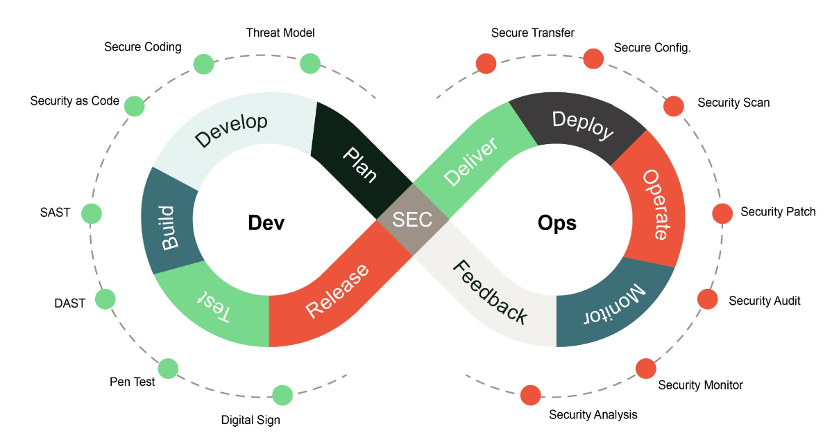
DevOps look
Continuous Integration
Continuous Integration drives the ongoing merging and testing of code, which leads to finding defects early.
Continuous Delivery
Continuous Delivery of software solutions to production and testing environments helps organizations quickly fix bugs and respond to ever-changing business requirements.
Version Control
Version Control, usually with a Git-based Repository, enables teams located anywhere in the world to communicate effectively during daily development activities.
Agile/lean
Plan and isolate work into sprints.
Manage team capacity and help teams quickly adapt to changing business needs.
A DevOps Definition of Done is working software collecting telemetry against the intended business goals.
Infrastructure as Code (IaC)
Enables the automation and validation of the creation and teardown of environments to help with delivering secure and stable application hosting platforms.
Microservices
Isolate business use cases into small reusable services that communicate via interface contracts.
Containers
Containers are the next evolution in virtualization
"DevOps is the union of people, process, and products to enable continuous delivery of value to end users."
– Donovan Brown, What is DevOps?
The idea is to create multidisciplinary teams that now work together with shared and efficient practices and tools.
Essential DevOps practices include agile planning, continuous integration, continuous delivery, and monitoring of applications. DevOps is a constant journey

Slide 5
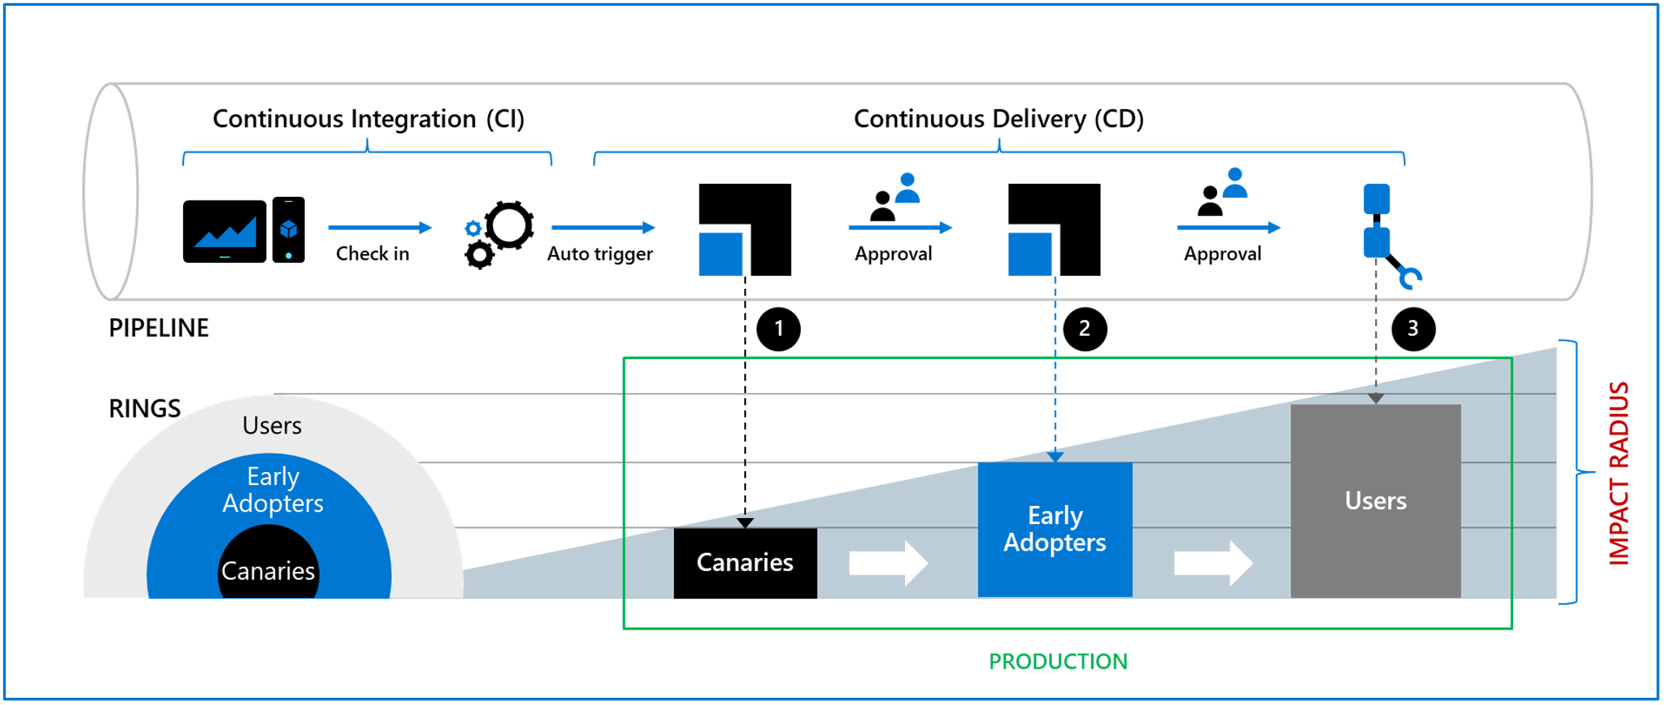
DevOps look
CI/CD:
Continuous Monitoring and Feedback
Plan
Code
Build
Test
Deploy
Run
Operate
Continuous Integration (CI)
A software development practice where members of a team integrate their work frequently. The fundamental goal of CI is to automatically catch problematic changes as early as possible.
Continuous Delivery (CD)
A software engineering approach in which teams produce software in short cycles and use processes ensuring that the software can be reliably released to production at any time.

Slide 6
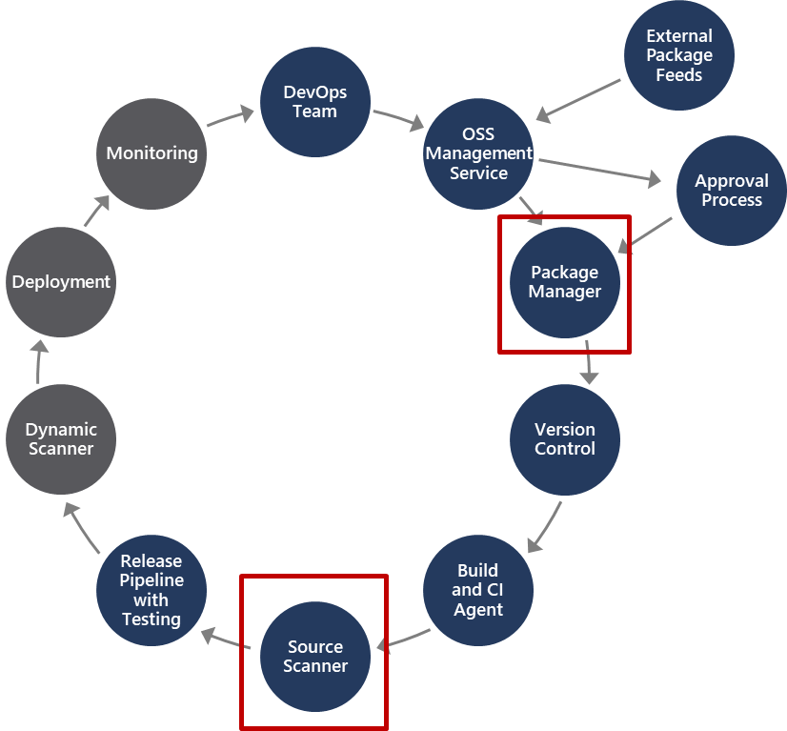
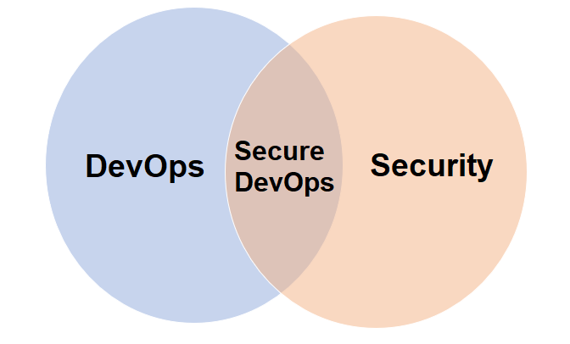
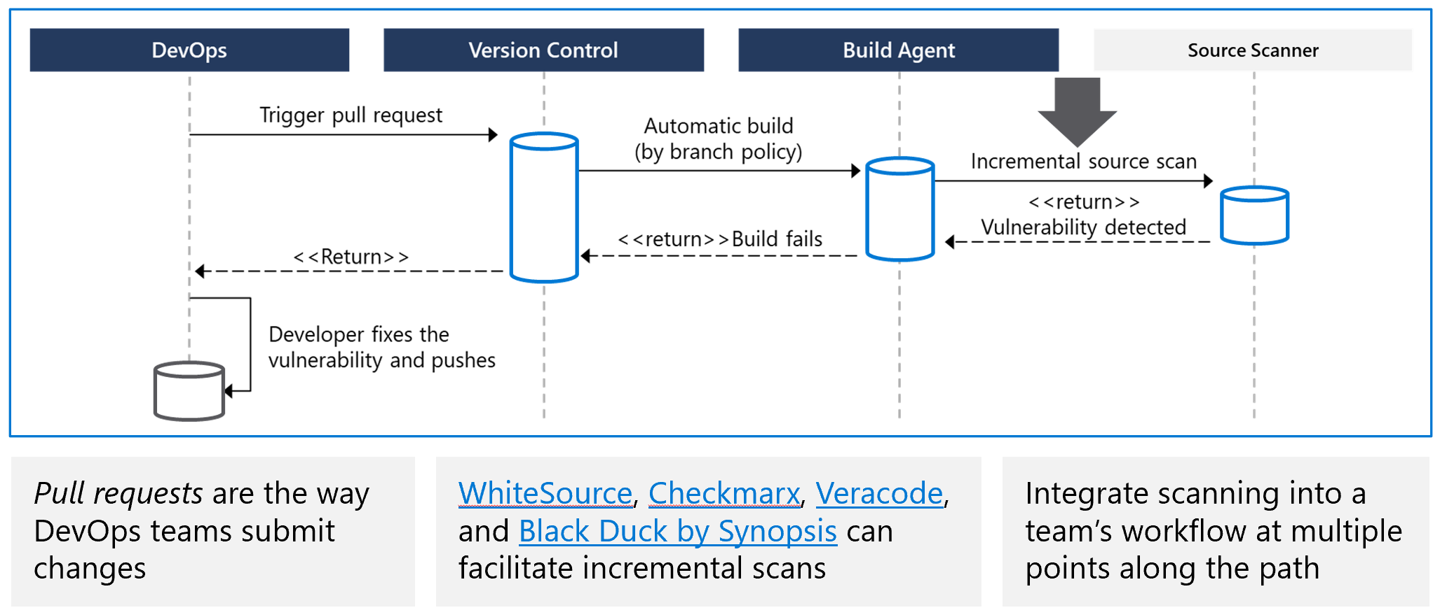
DevOps look
Secure DevOps is also sometimes referred to as DevSecOps

Slide 7
DevOps look: IaC
“…, more than ever now is the time for the infrastructure teams to adopt DevOps. However, few things need to be tweaked to apply DevOps framework for infrastructure teams. It is a journey which begins with a mindset change to do things differently with a continuous improvement and feedback process ultimately creating success for the company.”
DevOps is NOT for Infrastructure? | LinkedIn
App CI/CD:
Continuous Monitoring and Feedback
Plan
Code
Build
Test
Deploy
Run
Operate
Continuous Integration (CI)
Continuous Delivery (CD)
IaC CI/CD:
Continuous Monitoring and Feedback
Plan
Code
Orchestrate
Test
Provision
Operate
Continuous Integration (CI)
Continuous Delivery (CD)
Comparison to application development using DevOps approach:
More stable requirements
Less dynamic changes due to feature management
Canary on Dev/Test
Avoiding big-bang. Small changes in iterative way

Slide 8
2
IaC approaches

Slide 9
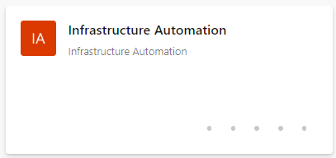
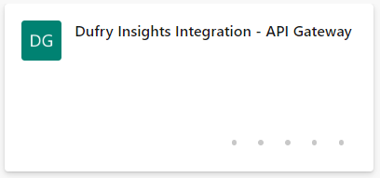
IaC approaches: enterprise vs. solution centric
Enterprise automation
whole infrastructure automation
prefer owning Terraform code, third-party modules forked
environments (prod, dev, etc.) as the main unit of work
IaC lifecycle similar to application code lifecycle
Solution automation
single product / solution automation
limited capability to own Terraform code, third-party modules referenced from registry
"solution factory" where IaC is often embedded in an internal user facing application
Example: main.tf - Repos (azure.com)
Example: kv.tf - Repos (azure.com)

Slide 10
IaC approaches: Terraform in Organization
An Azure landing zone is the output of a multi-subscription Azure environment that accounts for scale, security governance, networking, and identity. An Azure landing zone enables application migration, modernization, and innovation at enterprise-scale in Azure.
Landing Zone can be broken down into multiple components (rather called as modules in IaC) as below.
Networking
Identity & access management
Connectivity
Management group
Shared Services
What's the Terraform code lifecycle?
How many repositories will hold the code?
How many teams do the actual work on the code?
Where are modules hosted?
Who can commit, approve, merge in each repository?
How are automation pipelines designed, and which identity do they use?
Some customer scenarios we have seen
Infra team manages core services (networking, DNS, connectivity, etc.) and prepares folders and projects for the application teams, who are then free to create resources in them
Infra team create blueprints of services as Terraform modules, and the application teams request their instantiation by providing specific variables
HashiCorp Terraform is an open-source infrastructure as code (IaC) software tool that allows DevOps engineers to programmatically provision the physical resources an application requires to run. Infrastructure as code is an IT practice that manages an application's underlying IT infrastructure through programming.

Slide 11
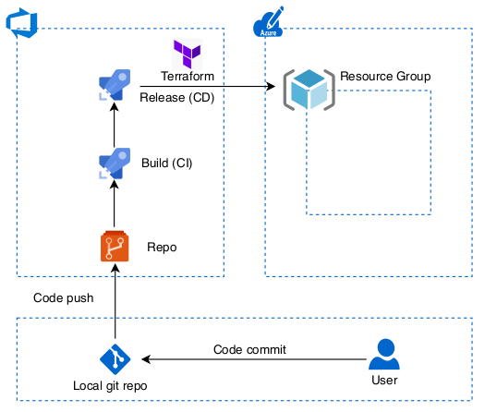
IaC approaches: Repository design
Design your repository layout early on
Centralize modules in their own repository, and define versioning best practices
Define the approach used to manage environments
Define how to share global variables (billing account ids, regions, IP space, etc.)
Define the layout of application team IaC repositories, and if state sharing is needed
Best practices
Fork and own third-party modules, don't inject external dependencies in your code
Layout of the core infra repository
Gitlab/Git Flow
One repository per environment
Share global variables via a "static" versioned module
Centralize application team IaC repositories

Slide 12
IaC approaches: Code ownership
Decide who owns the infrastructure
Your infrastructure is composed of different layers (central networking, security, shared services/infra, applications)
How does this separation map to control and access levels?
How does this reflect on IaC design?
What degree of freedom do application teams have?
Where is the boundary for IaC and Gitops?
Some customer scenarios we have seen
Central management of core infra and project creation; no enforced control on application teams
Central management of core infra and project creation; application teams using centrally managed modules that encode allowed application "patterns"
Central management of the whole infrastructure, Gitops workflow enforced down to the application

Slide 13
IaC approaches: Readability
How your IaC is designed influences how quickly your infrastructure reacts
What are the abstraction layers, and how easy are they to navigate?
Are your variables descriptive?
What's the logic used to draw module boundaries?
Is there consistency between the different modules, or between different Terraform repositories?
Some tips
Design modules so they're true to the underlying resources (e.g. IAM, attribute naming, etc.)
Implement local abstractions in environments (e.g. by mapping workflow access patterns to variables)
Group all accessory resources in the main resource module (e.g. project services, IAM, org policies)

Slide 14
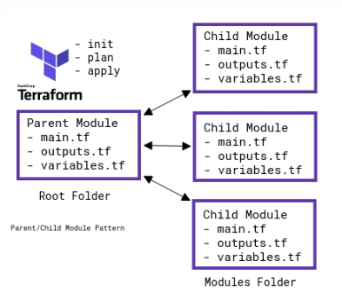
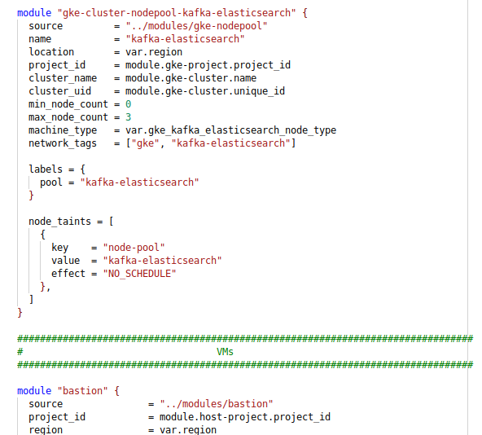
IaC approaches: Modular approach
Encapsulate components in modules
Allow for easier testing
Leverage module versioning for simple rollout of changes
Improve root-level code readability and navigation
Use modules to abstract resources and create top-level code that matches the architectural design
Keep modules simple and flexible

Slide 15
3
Responsibility

Slide 16
Responsibility
Scope | Who | How | What
Org setup | cloud / infra team | manual | automation resources, initial org roles, audit logging
Hierarchy | cloud / infra team | CI/CD | org-level hierarchy (folders, roles, shared projects)
Security | security team | CI/CD | org-level security resources (sinks, KMS, CSCC, etc.)
Networking | network team | CI/CD | shared networking resources (ICs, VPC hosts, etc.) possibly leverage YAML/JSON for firewall and subnets
Modules | cloud / infra team | N/A | central module repository
Projects (factory) | cloud / infra team | CI/CD or portal | managed/automated provisioning of projects possibly leverage YAML/JSON as data format
VMs (factory) | cloud / infra team | CI/CD or portal | managed/automated provisioning of instances possibly leverage YAML/JSON as data format
App binaries | application team | CI/CD | release application into landing zone

Slide 17
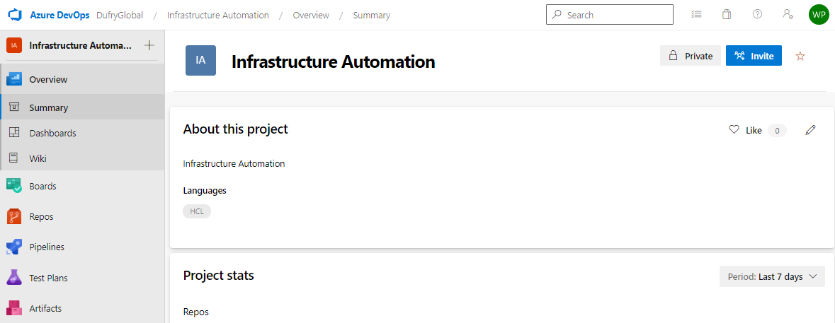
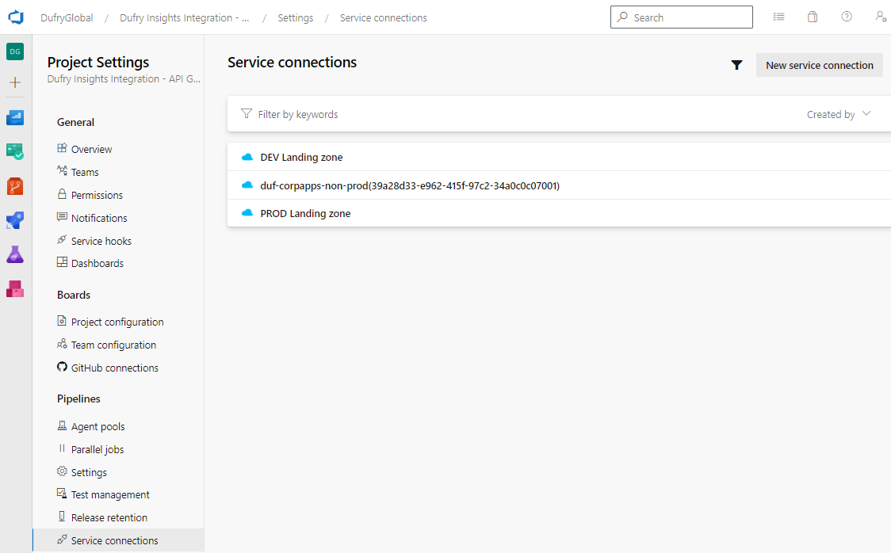
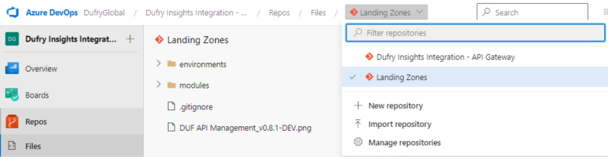
Responsibility: Configuration items ownership of Infra Team (projects)
Enterprise automation
Solution automation
Project “Infrastructure Automation”
Project > Project settings > service connection
Project > Repos > Files > IaC

Slide 18
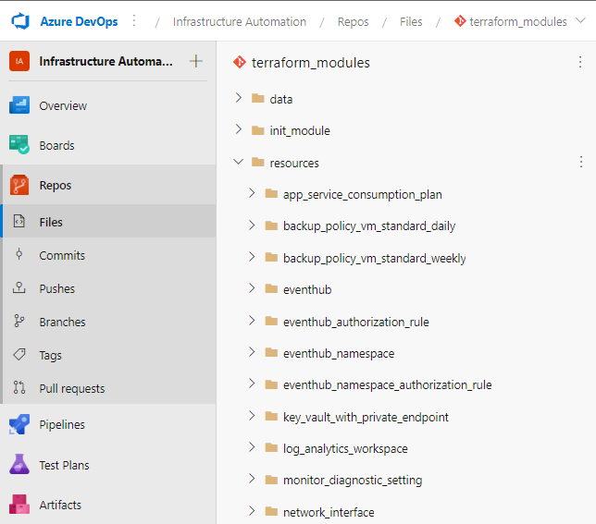
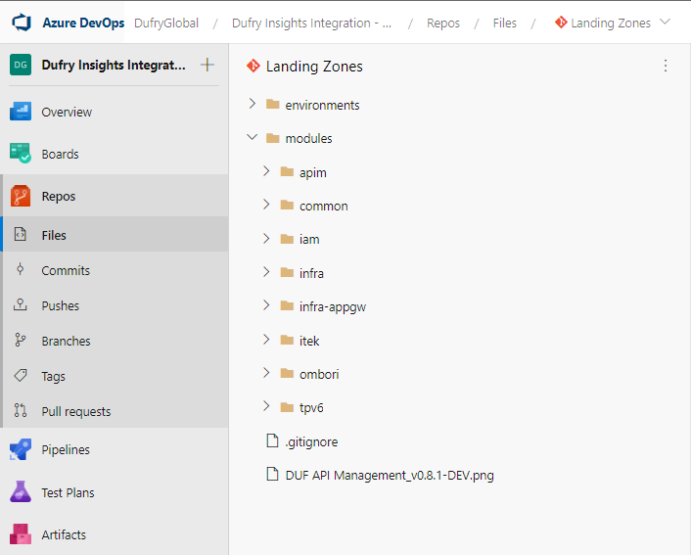
Responsibility: Configuration items ownership of Infra Team (templates)
Enterprise automation
Solution automation

Slide 19
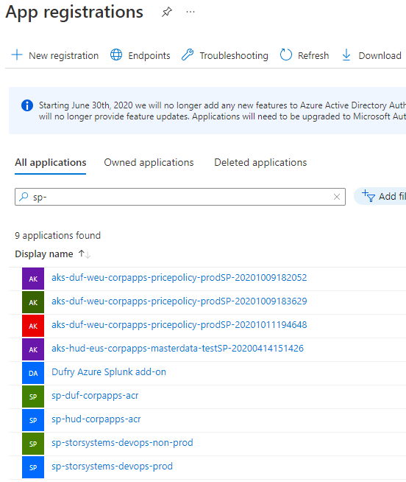
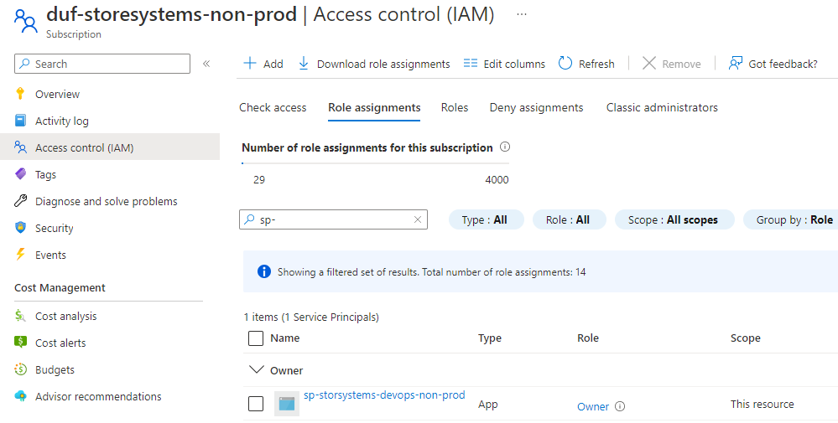
Responsibility: Configuration items ownership of Infra Team (IAM)
Service principals
Role assignment

Slide 20
4
Governance changes and improvements

Slide 21
Governance: Changes and improvements
Infrastructure Lifecycle Management covers the management of all core processes around planning, creation, operation, and maintenance.
Change management process:
Developer
Continuous Integration
Detect code change
Change code
Push to repository
Run sec tests
Provision in DEV
Run unit tests
Continuous Delivery
Detect new request
Provision to canary (TEST)
Functional tests of canary reelease
Manual approval
Provision to production (blue/green)
Tear down canary
Deprovision DEV / TEST
Wait 30 minutes
Wait 2 hours

Slide 22

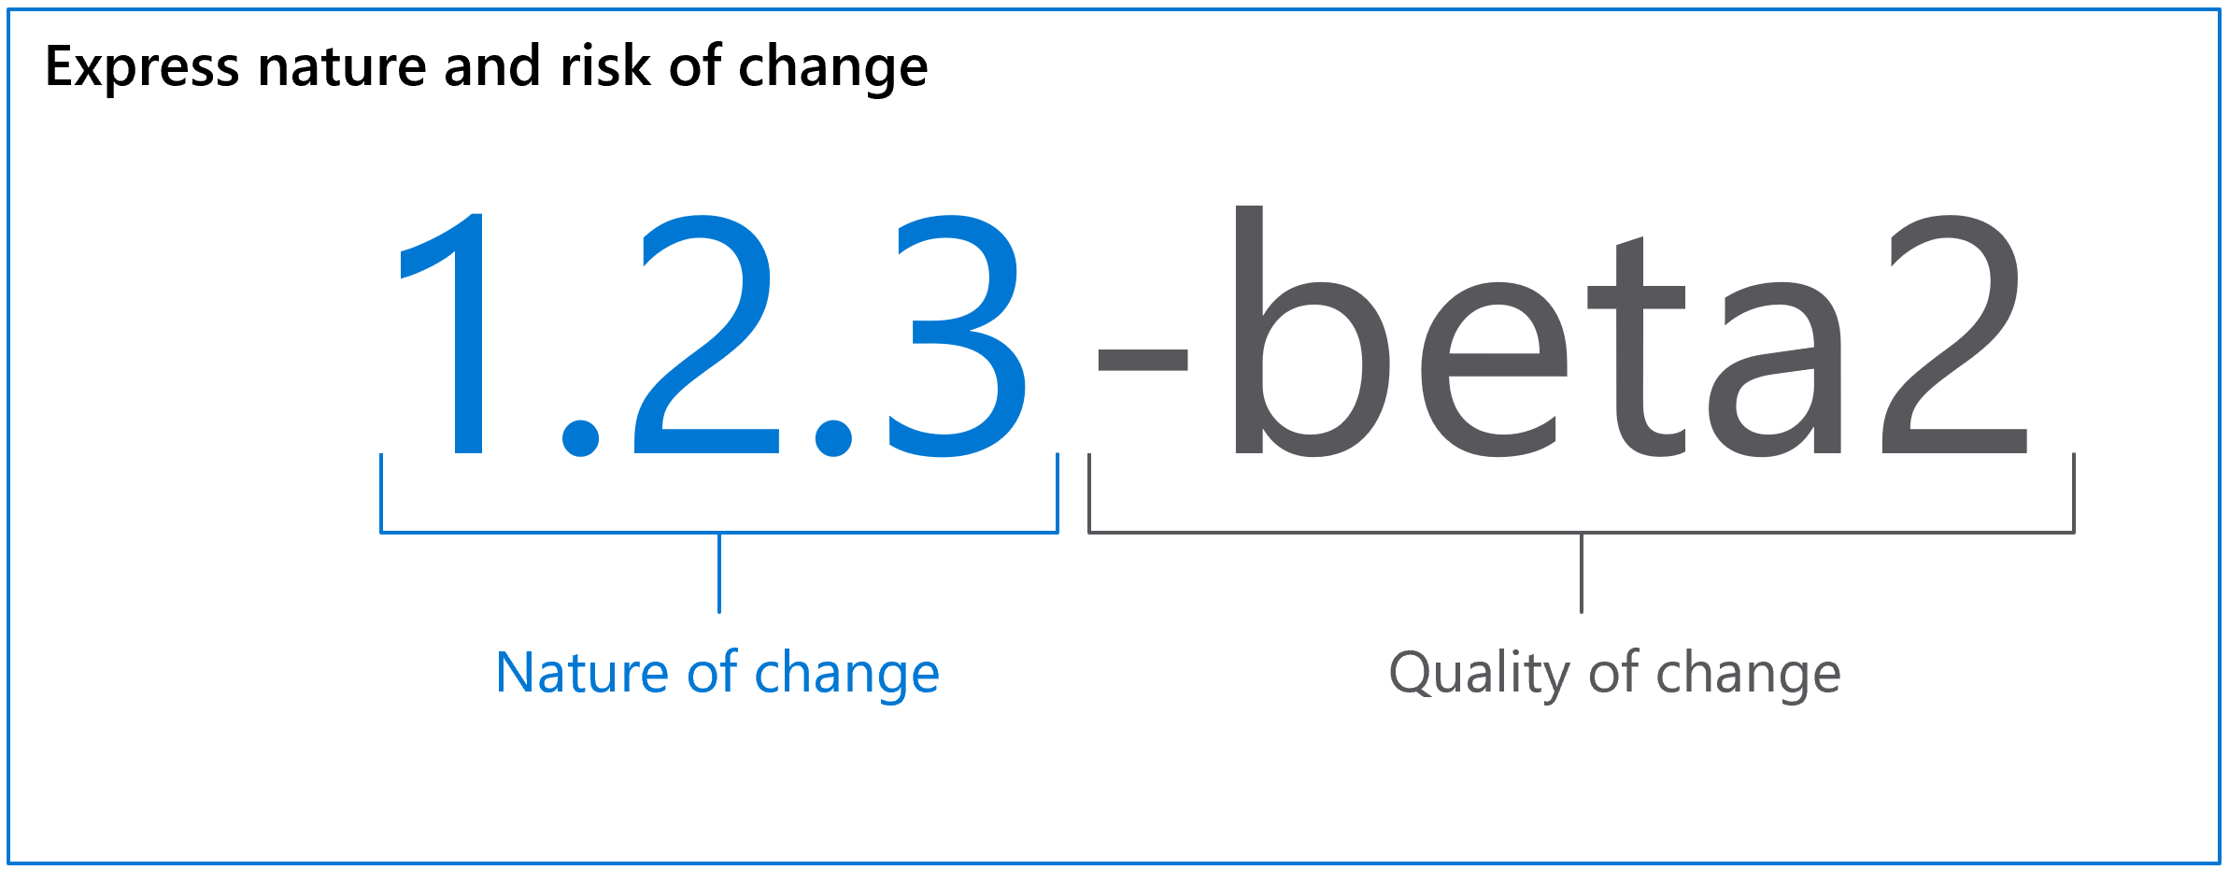
Governance: Lifecycle management
Versioning
Semantic Versioning 2.0.0 | Semantic Versioning (semver.org)

Slide 23
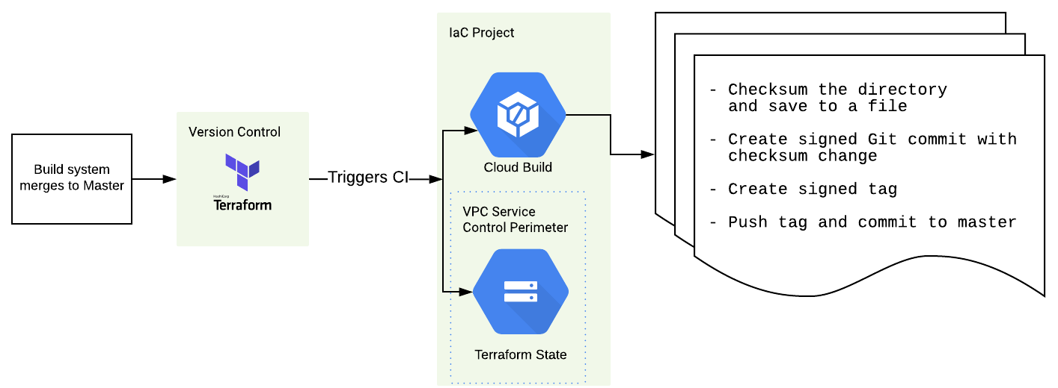
Governance: Lifecycle management
Signing
Now we can verify commit signature
as well as shasum before applying to
real infrastructure

Slide 24
5
Issues / gaps

Slide 25
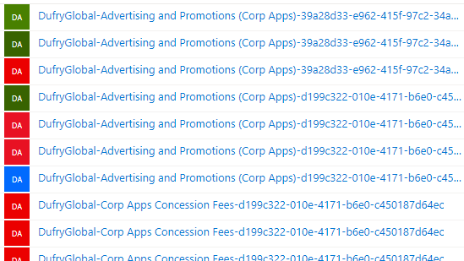
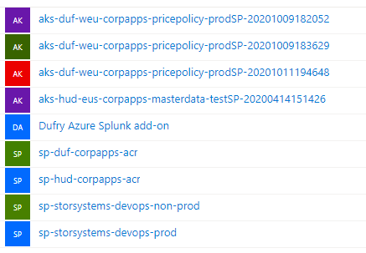
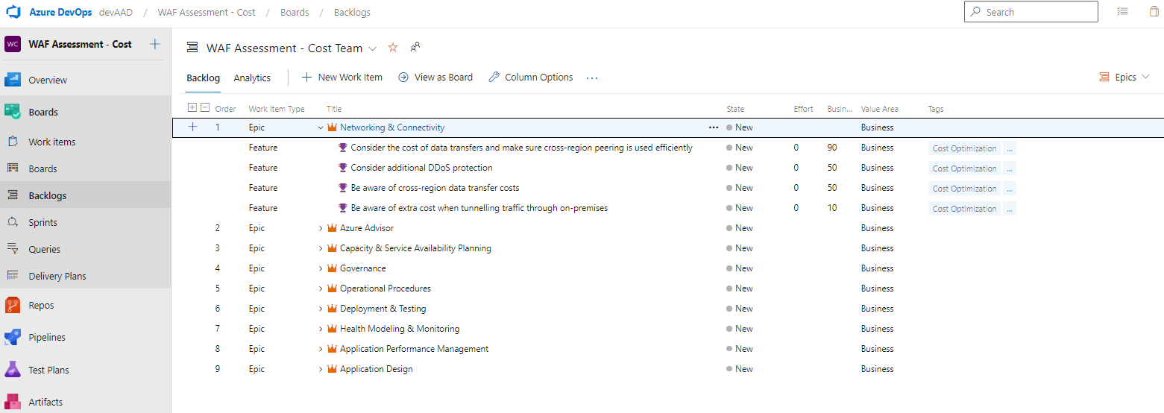
Issues / gaps / challenges
Infra Team skills
AZ-104: “Microsoft Azure Administrator”
AZ-204: “Developing Solutions for Microsoft Azure”
AZ-400: “Designing and Implementing Microsoft DevOps solutions”
Application architecture
Approval flow
“Enterprise automation”: SNOW > Inc
“Solution automation”: Infra approver in app pipelines
IAM
Azure Resource Manager using service principal (automatic)
vs.
Azure Resource Manager using service principal (manual)
Team workload organized using agile approach
Introduce Scrum
Use Kanban to manage backlog
“Zero-touch” principal
None manual configuration of landing-zones
DevSecOps
SonarQube, Visual Studio Code Analysis, Qualys IaC Scan, …

Slide 26
Thank you

